Slide 1

The Science of Psychology
Chapter 1

Slide 2
Chapter 1 Learning Objective Menu
LO 1.1 Definition and goals of psychology
LO 1.2 Structuralism and functionalism
LO 1.3 Early Gestalt, psychoanalysis, and behaviorism
LO 1.4 Modern perspectives
LO 1.5 Skinner, Maslow, and Rogers
LO 1.6 Psychiatrist, psychologist, and other professionals
LO 1.7 Psychology is a science; steps in scientific method
LO 1.8 Naturalistic and laboratory settings
LO 1.9 Case studies and surveys
LO 1.10 Correlational technique
LO 1.11 Experimental approach and terms
LO 1.12 Placebo and the experimenter effects
LO 1.13 Conducting a real experiment
LO 1.14 Ethical concerns in conducting research
LO 1.15 Principles of critical thinking
LO 1.16 Apply critical thinking to a real world example

Slide 3
What is Psychology?
LO 1.1 Definition and goals of psychology
Psychology - scientific study of behavior and mental processes.
  Behavior - outward or overt actions and reactions.
  Mental processes - internal, covert activity of our minds.
Psychology is a science
  Prevent possible biases from leading to faulty observations
  Precise and careful measurement
Menu

Slide 4
Psychology’s Four Goals
LO 1.1 Definition and goals of psychology
Description
  What is happening?
Explanation
  Why is it happening?
  Theory - general explanation of a set of observations or facts
Prediction
  Will it happen again?
Control
  How can it be changed?
Menu

Slide 5
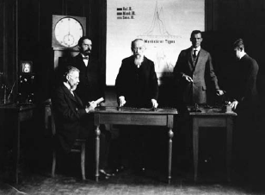
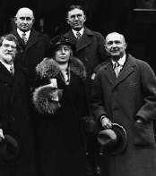
Structuralism
LO 1.2 Structuralism and functionalism
Structuralism - focused on structure or basic elements of the mind.
Wilhelm Wundt’s psychology laboratory
  Germany in 1879
  Developed the technique of objective introspection – process of objectively examining and measuring one’s thoughts and mental activities.
Edward Titchener
  Wundt’s student; brought structuralism to America.
Margaret Washburn
  Titchener’s student; first woman to earn a Ph.D. in psychology.
Structuralism died out in early 1900s.
Menu

Slide 6
Functionalism
LO 1.2 Structuralism and functionalism
Functionalism - how the mind allows people to adapt, live, work, and play.
Proposed by William James.
Influenced the modern fields of:
  Educational psychology
  Evolutionary psychology
  Industrial/organizational psychology
Menu

Slide 7

Gestalt Psychology
LO 1.3 Early Gestalt, psychoanalysis, and behaviorism
Gestalt – “good figure” psychology.
Started with Wertheimer, who studied sensation and perception.
Gestalt ideas are now part of the study of cognitive psychology, a field focusing not only on perception but also on learning, memory, thought processes, and problem solving.
Menu

Slide 8
Psychoanalysis
LO 1.3 Early Gestalt, psychoanalysis, and behaviorism
Psychoanalysis - the theory and therapy based on the work of Sigmund Freud.
Freud’s patients suffered from nervous disorders with no found physical cause.
  Freud proposed that there is an unconscious (unaware) mind into which we push, or repress, all of our threatening urges and desires.
  He believed that these repressed urges, in trying to surface, created nervous disorders.
  Freud stressed the importance of early childhood experiences.
Menu

Slide 9
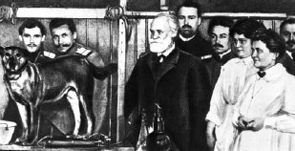
Behaviorism
LO 1.3 Early Gestalt, psychoanalysis, and behaviorism
Behaviorism - the science of behavior that focuses on observable behavior only.
  Must be directly seen and measured.
Proposed by John B. Watson.
  Based much from work of Ivan Pavlov who demonstrated that a reflex could be conditioned (learned).
  Watson believed that phobias were learned.
    Case of “Little Albert” – taught to fear a white rat.
Menu

Slide 10
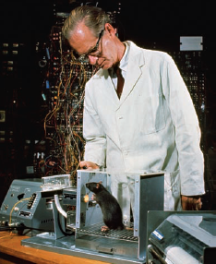
Seven Modern Perspectives
LO 1.4 Modern perspectives / LO 1.5 Skinner, Maslow, and Rogers
Psychodynamic perspective - modern version of psychoanalysis.
  More focused on the development of a sense of self and the discovery of other motivations behind a person’s behavior than sexual motivations.
Behavioral perspective – B. F. Skinner studied operant conditioning of voluntary behavior.
  Behaviorism became a major force in the twentieth century.
  Skinner introduced the concept of reinforcement to behaviorism.
Menu

Slide 11
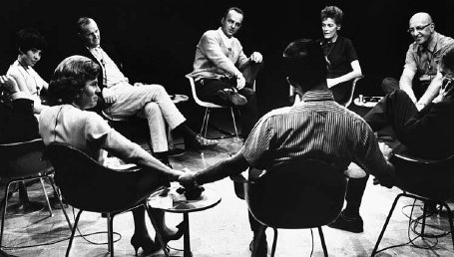
Seven Modern Perspectives
LO 1.4 Modern perspectives / LO 1.5 Skinner, Maslow, and Rogers
Humanistic perspective
  Owes far more to the early roots of psychology in the field of philosophy.
  Humanists held the view that people have free will, the freedom to choose their own destiny.
  Early founders:
    Abraham Maslow
    Carl Rogers
  Emphasized the human potential, the ability of each person to become the best person he or she could be.
    Self-actualization - achieving one’s full potential or actual self.
Menu

Slide 12
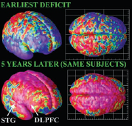
Seven Modern Perspectives
LO 1.4 Modern perspectives
Biopsychological perspective - attributes human and animal behavior to biological events occurring in the body, such as genetic influences, hormones, and the activity of the nervous system.
Cognitive perspective - focuses on memory, intelligence, perception, problem solving, and learning.
Menu

Slide 13

Seven Modern Perspectives
LO 1.4 Modern perspectives
Sociocultural perspective - focuses on the relationship between social behavior and culture.
Evolutionary perspective - focuses on the biological bases of universal mental characteristics that all humans share.
  Looks at the way the mind works and why it works as it does.
  Behavior is seen as having an adaptive or survival value.
Menu

Slide 14
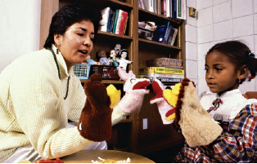
Types of Psychological Professionals
LO 1.6 Psychiatrist, psychologist, and other professionals
Psychiatrist - a medical doctor who has specialized in the diagnosis and treatment of psychological disorders.
Psychoanalyst - either a psychiatrist or a psychologist who has special training in the theories of Sigmund Freud and his method of psychoanalysis.
Psychiatric social worker - a social worker with some training in therapy methods who focuses on the environmental conditions that can have an impact on mental disorders, such as poverty, overcrowding, stress, and drug abuse.
Psychologist - a professional with an academic degree and specialized training in one or more areas of psychology.
  Can do counseling, teaching, and research and may specialize in any one of a large number of areas within psychology.
  Areas of specialization in psychology include clinical, counseling, developmental, social, and personality, among others.
Menu

Slide 15
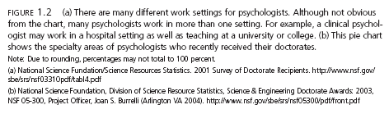
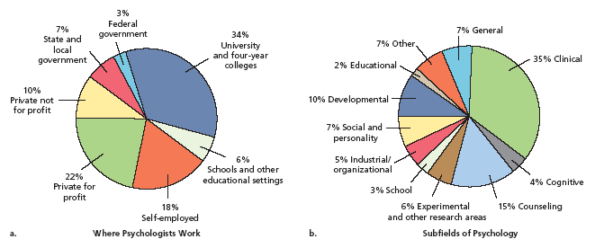
LO 1.6 Psychiatrist, psychologist, and other professionals
Menu

Slide 16
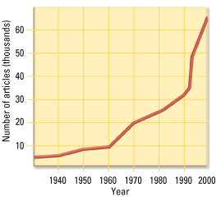
LO 1.6 Psychiatrist, psychologist, and other professionals
Growth of psychology
Menu

Slide 17
Psychology and the Scientific Method
LO 1.7 Psychology is a science; steps in scientific method
Scientific method - system of gathering data so that bias and error in measurement are reduced.
Steps in the Scientific Method:
    Perceive the question.
    Form a hypothesis – tentative explanation of a phenomenon based on observations.
    Test the hypothesis.
    Draw conclusions.
    Report your results so that others can try to replicate - repeat the study or experiment to see if the same results will be obtained in an effort to demonstrate reliability of results.
Menu

Slide 18
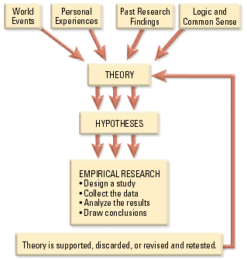
LO 1.7 Psychology is a science; steps in scientific method
The Scientific Method
Menu

Slide 19
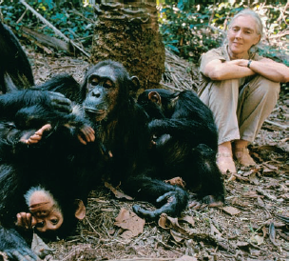
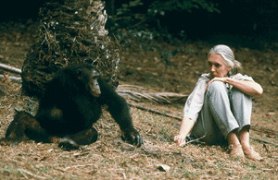
Descriptive Methods
LO 1.8 Naturalistic and laboratory settings
Naturalistic observation – watching animals or humans behave in their normal environment.
Major Advantage:
  Realistic picture of behavior.
Disadvantages:
  Observer effect - tendency of people or animals to behave differently from normal when they know they are being observed.
    Participant observation - a naturalistic observation in which the observer becomes a participant in the group being observed (to reduce observer effect).
  Observer bias - tendency of observers to see what they expect to see.
    Blind observers – people who do not know what the research question is (to reduce observer bias).
  Each naturalistic setting is unique and observations may not hold.
Menu

Slide 20
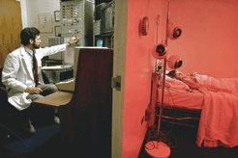
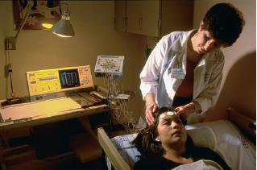
Descriptive Methods
LO 1.8 Naturalistic and laboratory settings
Laboratory observation – watching animals or humans behave in a laboratory setting.
Advantages:
  Control over environment.
  Allows use of specialized equipment.
Disadvantage:
  Artificial situation that may result in artificial behavior.
Descriptive methods lead to the formation of testable hypotheses.
Menu

Slide 21
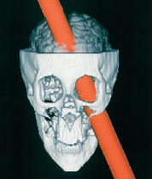
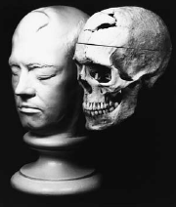
Descriptive Methods
LO 1.9 Case studies and surveys
Case study - study of one individual in great detail.
  Advantage: tremendous amount of detail.
  Disadvantage: cannot apply to others.
  Famous case study: Phineas Gage.
Menu

Slide 22
Descriptive Methods
LO 1.9 Case studies and surveys
Surveys – researchers will ask a series of questions about the topic under study.
Given to a representative sample - randomly selected sample of subjects from a larger population of subjects.
    Population - the entire group of people or animals in which the researcher is interested.
Advantages:
  Data from large numbers of people.
  Study covert behaviors.
Disadvantages:
  Have to ensure representative sample (or results not meaningful).
  People are not always accurate (courtesy bias).
Menu

Slide 23

Random Sampling from Population
LO 1.9 Case studies and surveys
INFERENCE
POPULATION
SAMPLE
Menu

Slide 24
Finding Relationships
LO 1.10 Correlational technique
Correlation - a measure of the relationship between two variables.
  Variable - anything that can change or vary.
  Measures of two variables go into a mathematical formula and produce a correlation coefficient (r), which represents two things:
    direction of the relationship.
    strength of the relationship.
  Knowing the value of one variable allows researchers to predict the value of the other variable.
Menu

Slide 25
Finding Relationships
LO 1.10 Correlational technique
Correlation coefficient ranges from –1.00 to +1.00.
Closer to 1.00 or -1.00, the stronger the relationship between the variables.
  No correlation = 0.0.
  Perfect correlation = -1.00 OR +1.00.
Positive correlation – variables are related in the same direction.
  As one increases, the other increases; as one decreases, the other decreases.
Negative correlation – variables are related in opposite direction.
  As one increases, the other decreases.
CORRELATION DOES NOT PROVE CAUSATION!!!
Menu

Slide 26

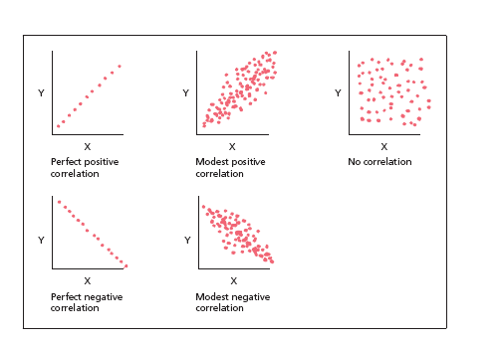
LO 1.10 Correlational technique
Menu

Slide 27
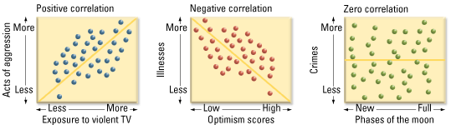
LO 1.10 Correlational technique
Menu

Slide 28
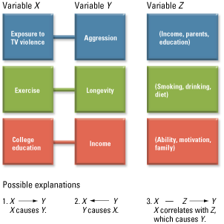
LO 1.10 Correlational technique
Correlation does NOT prove causation
Menu

Slide 29
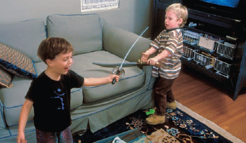
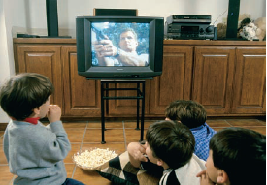
The Experiment
LO 1.11 Experimental approach and terms
Experiment - a deliberate manipulation of a variable to see if corresponding changes in behavior result, allowing the determination of cause-and-effect relationships.
Operational definition - definition of a variable of interest that allows it to be directly measured.
Independent variable (IV) - variable in an experiment that is manipulated by the experimenter.
Dependent variable (DV) - variable in an experiment that represents the measurable response or behavior of the subjects in the experiment.
Definition: Aggressive play
IV: Violent TV
DV: Aggressive play
Menu

Slide 30
The Experiment
LO 1.11 Experimental approach and terms
Experimental group - subjects in an experiment who are subjected to the independent variable.
Control group - subjects in an experiment who are not subjected to the independent variable and who may receive a placebo treatment (controls for confounding variables).
Random assignment - process of assigning subjects to the experimental or control groups randomly, so that each subject has an equal chance of being in either group.
  Controls for confounding (extraneous, interfering) variables.
Exp Group: Watch TV
Control Group: No TV
Menu

Slide 31
Random Assignment
LO 1.11 Experimental approach and terms
Experimental Group
SAMPLE
Test for Differences
Control Group
Menu

Slide 32


Confounding Variables
LO 1.11 Experimental approach and terms
Experimental Group
SAMPLE
Are differences due to manipulation or confounding variable (mood)?
Control Group
Menu

Slide 33
No Confounding Variables
LO 1.11 Experimental approach and terms
Experimental Group
SAMPLE
Differences due to manipulation, not an extraneous variable because mood randomly determined.
Control Group
Menu

Slide 34
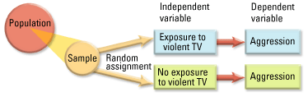
LO 1.11 Experimental approach and terms
The Experiment
Menu

Slide 35
The Experiment
LO 1.12 Placebo and the experimenter effects
Placebo effect - the phenomenon in which the expectations of the participants in a study can influence their behavior.
  Single-blind study- subjects do not know if they are in the experimental or the control group (reduces placebo effect).
Experimenter effect - tendency of the experimenter’s expectations for a study to unintentionally influence the results of the study.
  Double-blind study - neither the experimenter nor the subjects knows if the subjects are in the experimental or control group (reduces placebo effect and experimenter effect).
Quasiexperimental designs - not considered true experiments because of the inability to randomly assign participants to the experimental and control groups (for example, if age is the variable of interest).
Menu

Slide 36

Example of a Real Experiment
LO 1.13 Conducting a real experiment
Hypothesis: extrinsic (external) reward would reduce creativity.
Independent variable – two different sets of instructions.
Dependent variable – creativity on art project as judged by raters blind to the group assignment.
Experimental group – instructed to make project to compete for an award (prizes).
Control group – instructed to make project for fun; prizes would be raffled off.
Results supported hypothesis: those competing for extrinsic reward were less creative.
Menu

Slide 37
Ethics in Psychological Research
LO 1.14 Ethical concerns in conducting research
Ethics committees - groups of psychologists or other professionals who look over each proposed research study and judge it according to its safety and consideration for the participants in the study.
Common ethical guidelines:
  Rights and well-being of participants must be weighed against the study’s value to science.
  Participants must be allowed to make an informed decision about participation.
  Deception must be justified.
  Participants may withdraw from the study at any time.
  Participants must be protected from risks or told explicitly of risks.
  Investigator must debrief participants, telling the true nature of the study and expectations of results.
  Data must remain confidential.
Menu

Slide 38
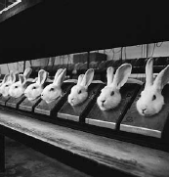
Ethics in Psychological Research
LO 1.14 Ethical concerns in conducting research
Animal research – answers questions we could never do with human research.
Focus is on avoiding exposing them to unnecessary pain or suffering.
Animals are used in approximately 7% of psychological studies.
These rabbits are part of a drug-testing study. Their bodies are enclosed in the metal cases to prevent movement during the test. What steps might the researchers using these animals take to
treat the animals ethically?
Menu

Slide 39
Critical Thinking
LO 1.15 Principles of critical thinking
Critical thinking - making reasoned judgments about claims.
Four Basic Criteria:
  There are very few “truths” that do not need to be subjected to testing.
  All evidence is not equal in quality.
  Just because someone is considered to be an authority or to have a lot of expertise does not make everything that person claims automatically true.
  Critical thinking requires an open mind.
Menu

Slide 40
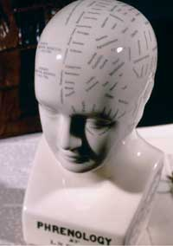
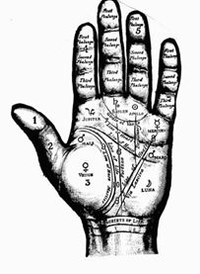
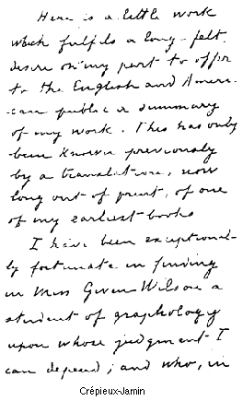
Pseudopsychologies
LO 1.15 Principles of critical thinking
Pseudopsychologies - systems of explaining human behavior that are not based on or consistent with scientific evidence.
  Phrenology – reading bumps on the skull.
  Palmistry – reading palms.
  Graphology – analysis of personality through handwriting.
Menu

Slide 41
Critical Thinking Application
LO 1.16 Apply critical thinking to a real world example
Critical thinking applied to astrology (a pseudopsychology):
  Are astrologer’s charts up-to-date? The basic astrological charts were designed over 3,000 years ago. The stars, planets, and constellations are no longer in the same positions in the sky due to changes in the rotation of the Earth’s axis over long periods of time—over 24 degrees in just the last 2,000 years. So a Gemini is really a Cancer and will be a Leo in another 2,000 years.
  What exactly is so important about the moment of birth? Why not the moment of conception? What happens if a baby is born by cesarean section and not at the time it would have been born naturally? Is that person’s whole life screwed up?
  Why would the stars and planets have any effect on a person? Is it gravity? The body mass of the doctor who delivers the baby has a far greater gravitational pull on the infant’s body than the moon. (Maybe people should use skinny obstetricians?)
Menu

Slide 42
Web Resources
APA - American Psychological Association: http://www.apa.org
Information about the APA and links to other sites.
APS - American Psychological Society; http://www.psychologicalscience.org
Information about the APS and links to other sites.
Cognitive Neuroscience Society: http://www.dartmouth.edu/~cns/
Cognitive Neuroscience Society is committed to the development of mind and brain research aimed at investigating the psychological, computational, and neuroscientific bases of perception and cognition. Since its founding in 1994, the Society has been dedicated to bringing its 1000 worldwide members the latest research and dialogues, so that thoughtful analysis can take place within both public and professional circles.
Division 3 of the American Psychological Association: http://www.apa.org/divisions/div3/
The Division of Experimental Psychology of the American Psychological Association was formed many years ago to represent the interests and concerns of psychologists whose principal area of study or research lies within the field of general experimental psychology.
Division 7 of the American Psychological Association: http://classweb.gmu.edu/awinsler/div7/homepage.shtml
Division 7 was organized to (a) promote research in the field of Developmental Psychology; (b) foster the development of researchers through providing information about educational opportunities and recognizing outstanding contributions to the discipline; (c) facilitate exchange of scientific information about developmental psychology through publications such as the division’s newsletter and through national and international meetings; and (d) promote high standards for the application of scientific knowledge on human development to public policy issues.
Menu

Slide 43
Web Resources
Experimental Psychology Society: http://www.eps.ac.uk/
The Experimental Psychology Society is for the furtherance of scientific inquiry within the field of Psychology and cognate subjects. It holds periodical meetings at which papers are read and discussions held. The Society also disseminates information and educational material made available as a consequence of psychological research, including the publication of the Quarterly Journal of Experimental Psychology (Section A: Human Experimental Psychology, and Section B: Comparative and Physiological Psychology).
Jean Piaget Society: http://www.piaget.org/
This site was created as an information resource for members of the Jean Piaget Society. The Jean Piaget Society, established in 1970, has an international, interdisciplinary membership of scholars, teachers and researchers interested in exploring the nature of the developmental construction of human knowledge.
Philosophy of Science Association: http://philosophy.wisc.edu/PSA/Default.htm
The Philosophy of Science Association aims to further studies and free discussion from diverse standpoints in the field of philosophy of science. To this end, the PSA engages in activities such as: the publishing of periodicals, essays and monographs in this field; sponsoring conventions and meetings; and the awarding of prizes for distinguished work in the field.
Menu

Slide 44
Web Resources
Psychonomic Society: http://www.psychonomic.org/ Psychonomic Society
One of the premier organizations of modern experimental psychology. The Psychonomic Society promotes the communication of scientific research in psychology and allied sciences
Society of Clinical Psychology :http://www.apa.org/divisions/div12/homepage.html
This site is sponsored by Division 12 of APA and addresses a variety of research, theory, and practice issues associated with clinical psychology.
Society of Counseling Psychology: http://www.div17.org/
Division 17 - Counseling Psychology was founded in 1946 to promote personal, educational, vocational, and group adjustment in a variety of settings. Presently, Division 17 brings together psychologists, students, and international and professional affiliates who are dedicated to promoting education and training, scientific investigation, practice, and diversity and public interest in professional psychology.
Society of Experimental Social Psychology (SESP): http://www.sesp.org/
SESP is a scientific organization dedicated to the advancement of social psychology.
Menu

Slide 45
Web Resources
Society for Personality and Social Psychology: http://www.spsp.org/
With over 4,000 members, the Society is the largest organization of social and personality psychologists in the world. The goals of the Society are to further the generation and dissemination of research in personality and social psychology.
Society for Psychological Study of Social Issues :http://www.spssi.org/
SPSSI is an international group of over 3500 psychologists, allied scientists, students, and others who share a common interest in research on the psychological aspects of important social issues. In various ways, the Society seeks to bring theory and practice into focus on human problems of the group, the community, and nations, as well as the increasingly important problems that have no national boundaries.
Society for Research in Child Development: http://www.srcd.org/
The Society is a multidisciplinary, not-for-profit, professional association with a membership of approximately 5,500 researchers, practitioners, and human development professionals from over 50 countries.
The purposes of the Society are to promote multidisciplinary research in the field of human development, to foster the exchange of information among scientists and other professionals of various disciplines, and to encourage applications of research findings.
Menu

Slide 46
Web Resources
General/comprehensive
Amoeba Web: http://vanguard.edu/faculty/ddegelman/amoebaweb/
A site containing nicely organized tables of links to web pages related to various topics in psychology.
Centre for Psychology Resources: http://psych.athabascau.ca/html/aupr/psycres.shtml
A site maintained by Athabasca University in Canada. Provides comprehensive information on a variety of psychology topics.
PsychCrawler http://www.psychcrawler.com/
Want a search engine just for information about psychology? PsychCrawler allows you to search for journal articles, books, and web content.
Psychwatch: http://www.psychwatch.com
Psychwatch began in April, 1998 as a free weekly email Newsletter detailing events and internet-related developments in the mental health field. It has since evolved into a global communication and information network, providing information to those in the healthcare and mental health care fields. The Psychwatch Newsletter has a readership of over 14,000 professionals and students in at least 106 different countries. Dr. Fritz Galette and Chris Nuesell are New York State Licensed Psychologists.
Menu

Slide 47
Web Resources
Psych Web: http://www.psychwww.com
A cornucopia of psychology-related links maintained by the Psychology Department at Georgia Southern University.
Psychology Central: http://www.psych-central.com/
Web links and online resources for psychology students and faculty.
Psychology Jumping Stand: http://www.indiana.edu:80/~iuepsyc/PsycJump.html
A list of sites for psychology students to explore, prepared by the Psychology Department at Indiana University.
Science & Pseudoscience Review in Mental Health: http://www.pseudoscience.org
“The Review” is an online resource for questioning “scientific” claims in mental health research and publishing. This is a great resource for student projects to explore various scientific claims related to EMDR, touch therapies, and hidden memories, just to name a few…
Social Psychology Network: http://www.socialpsychology.org/
Well-organized links related to topics in social psychology.
Tests, Tests, Tests: http://www.queendom.com/tests
A vast variety of psychological tests established and maintained by “Cyberia Shrink.”
Menu

Slide 48
Web Resources
History of Psychology
Archives of the History of American Psychology: http://www.uakron.edu/ahap
Psychology’s attic, maintained at the University of Akron.
Aristotle, Descartes, and Locke.: http://www.rbjones.com/rbjpub/philos/classics/index.htm
Links to full-text works by these authors.
Classics in the History of Psychology http://psychclassics.yorku.ca/
This document repository, complete with a search engine, allows you to read excerpts from classic papers in psychology.
History of Psychology: http://elvers.stjoe.udayton.edu/history/history.html
This site at the University of Dayton offers a glimpse at psychology’s past.
History of Psychology: http://server.bmod.athabascau.ca/html/aupr/history.htm
The Psychology Center’s History of Psychology page has many websites to choose from, including broad topics and those specific to the history of psychology. Your students can learn more about psychology’s past or investigate the history of a particular topic that interests them.
Menu

Slide 49
Web Resources
History of Psychology: http://www.slu.edu/colleges/AS/PSY/510Guide.html
Complete and detailed resource guide to the history of psychology. Useful for preparing your remarks on this subject; fun to explore for your students. Assign a visit here as the basis for a short writing assignment or as a starter for an in-class discussion.
History of Psychology Timeline: http://www.geocities.com/Athens/Delphi/6061/en_linha.htm
History of Psychology Timeline from early civilization to the present. This is worth a visit by both you and your students. Recommend this to your students as a way of organizing their studying, by placing the right people and the right ideas at the right time.
Outlines of Psychology: http://www.yorku.ca/dept/psych/classics/Wundt/Outlines/
Translation of Wundt’s 1897 text. The online version is part of Classics in the History of Psychology, an Internet Resource developed by Christopher D. Green at York University, in Toronto.
Today in the History of Psychology: http://www.cwu.edu/~warren/today.html
Warren R. Street, of the University of Central Washington, knows everything about who was born when, who died when, what got published when, and what happened where.
Menu

Slide 50
Web Resources
Psychological theories
About Psychoanalysis: http://www.apsa.org/pubinfo.about.htm
An article on this topic from the American Psychoanalytic Association.
Humanistic Psychology and Humanistic Social Science: http://www.sonoma.edu/classes/psych490/fall96/writings/ArthurW/humsoc.html
An essay by Arthur Warmoth, Past President, Association for Humanistic Psychology.
Humanistic Psychology from Maslow to the 21st Century: http://www.ahpweb.org/aboutahp/whatis.html
A brief history of the humanistic psychology movement.
Interpretation of Dreams: http://www.psychwww.com/psychweb/books/interp/toc.htm
Sigmund Freud’s classic work is available on the Web in its entirety, courtesy of the folks at Georgia Southern University.
Mind and Body: Rene Descartes to William James: http://serendip.brynmawr.edu/Mind/Table.html
Robert H. Wozniak, of Bryn Mawr College, presents this history of ideas.

Slide 51
Web Resources
Postulates of a Structural Theory: http://www.yorku.ca/dept/psych/classics/Titchener/structuralism.htm
1898 paper by James Titchener, outlining structuralist theory, originally published in the Philosophical Review, 7, 449-465. The online version is part of “Classics in the History of Psychology,” an Internet Resource developed by Christopher D. Green at York University, in Toronto.
B.F. Skinner Foundation: http://www.bfskinner.org/
Read a biography of the famous behaviorist, complete a training course on his theories, and visit a media archive replete with audio and video clips. The B.F. Skinner Foundation was established in 1987 to educate the public about B. F. Skinner's work, and to promote an understanding of the role of contingencies in human behavior.
The Varieties of Religious Experience: http://www.psychwww.com/psyrelig/james/toc.htm
This work by William James is available in its entirety on the Web, courtesy of the folks at Georgia Southern University
John Broadus Watson: http://alpha.furman.edu/~einstein/watson/watson1.htm
This site provides a biography of Watson's life, complete with rare pictures.

Slide 52
Web Resources
Majoring in Psychology
Graduate Study in Psychology: http://www.uky.edu/Education/EDP/psyprog.html
Steer your students to this site to answer the many questions you undoubtedly answer yourself. “What’s the GRE?” “What do forensic psychologists do?” and “What’s the difference between a PsyD and a Ph.D.?” can be answered here.
Graduate Study in Psychology; http://www.lemoyne.edu/academic_affairs/d_ents/psychology/PsychSTAC/gradschool.html
Information about going to graduate school, including general books and resources, tips for what to consider, what to do, and information about admission tests.
Tipsheets for Psychology Majors: http://www.psychwww.com/tipsheet/index.html
Also from the Psychology Department at Georgia Southern University.

Slide 53
Web Resources
Careers in Psychology
American Psychological Association Student Resources: Careers in Psychology
http://www.apa.org.students/brochure/homepage.html
Information about what psychologists do and where they do it.
APA Divisions: http://apa.org/about/division.html
The American Psychological Association’s links to all of its divisions. Steer your students here to learn more about the major areas of psychology and what psychologists with these specializations do for a living.
Careers in Psychology: http://academic.uofs.edu/department/psych/handbook/x.html
A description of various career areas in psychology, including salary information.
Marky Lloyd’s Careers in Psychology Page: http://www.psywww.com/careers/index.htm
M.A. Lloyd at Georgia Southern University prepared this helpful site.

Slide 54
Web Resources
Psychologists: Careers for the 21st Century: http://www.apa.org/students/brochure/brochurenew.pdf
Job Outlook for the Next Two Decades. Remind your students that it’s good to have a job. Ask them to visit this page and report on the job prospects of psychologists for the next twenty years. Then, cheer them up with a few jokes and end class early.
Pursuing Psychology Career Page: http://www.uni.edu/walsh/lindal.html
Links to general career sites, resources for psychology majors, and career-related articles.
Ethics
APA Code of Ethics: http://www.apa.org/ethics/code.html
American Psychological Association’s Ethical Principles of Psychologists and Code of Conduct. Your students may be required to participate in experiments as part of their introductory course. Introduce them to this website either at the start of the semester (to allay their fears about participating in studies) or at the end (as a “wrap-up” paper comparing their research experiences with the ethical guidelines stated by APA).
Cloning (msnbc.com): http://www.msnbc.com/news/CLONING_front.asp
Articles on the pros and cons of cloning are available.

Slide 55
Web Resources
Ethics in Psychology: http://www.psych.bangor.ac.uk/deptpsych/Ethics/HumanResearch.html
This website links to several other ethics-related resources, such as position statements of review boards, guidelines at other institutions, or ethical principles of other organizations (e.g., the American Mathematical Association).
Research/Statistics
Research Methods: http://trochim.human.cornell.edu/ck/kblome.htm
The Knowledge Base: An Online Research Methods Textbook. Pretty much just what it says. If you include any detailed discussion of this topic in your Introductory Psychology course, this would be a worthwhile resource for your students.
Rice Virtual Lab in Statistics: http://www.ruf.rice.edu/%7Elane/rvls.html
Includes links to an online statistics textbook, simulations and demonstrations, case studies, and basic statistical analysis tools.
VassarStats: http://faculty.vassar.edu/lowry/VassarStats.html
Richard Lowry from Vassar College maintains this excellent site for statistical calculations.
Menu

